Slide 1
Multi-Agent (Deep) Reinforcement Learning
Aida Afshar Mohammadian
Aeirya Mohammadi
ML Course - Fall 1401
Dr. Rezazadegan

Slide 2
Overview
Introduction
Formal + Informal Definition of MARL
Multi-Agent Training Architectures
Distributed/Centralized + Training/Execution
Reward Structure
Emergent patterns of agent behavior
Hide and Seek
Petting Zoo

Slide 3
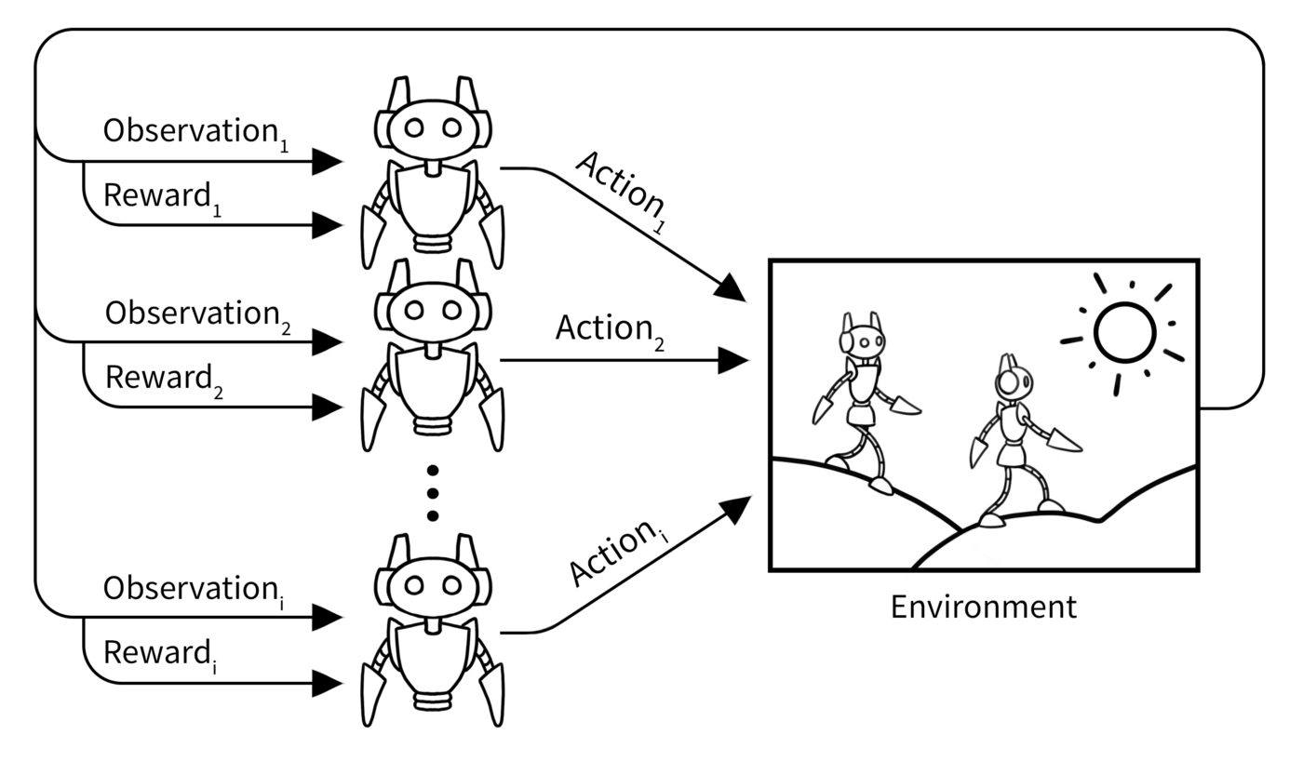
Introduction
A multi-agent system describes multiple distributed entities, so-called agents, which take decisions autonomously and interact within a shared environment. These agents require the ability to adapt and learn over time by themselves.
The most common framework to address learning in an interactive environment is Reinforcement Learning, which describes the change of behavior through a trial-and-error approach.

Slide 4
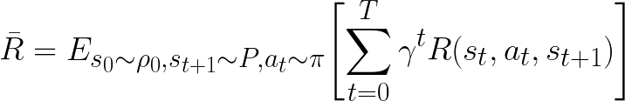
Single-Agent RL
Def 1 A Markov decision process (MDP) is formalized by the tuple (S, A, P, R, 𝛾 ) where S and A are the state and action space, respectively, P ∶ S × A → [0,1] is the transition function describing the probability of a state transition, R ∶ S × A × S → ℝ is the reward function providing an immediate feedback to the agent, and 𝛾 ∈ [0, 1) describes the discount factor.

Slide 5
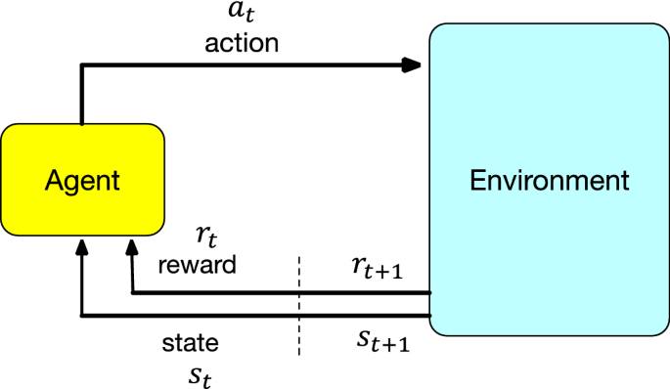
The agent’s goal is to act in such a way as to maximize the expected performance, regarding the policy π, over a predefined horizon T.

Slide 6
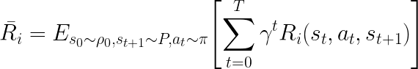
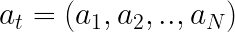
Multi-Agent RL
Def 2 The Markov Game (MG) is an extension to the MDP and is formalized by the tuple (N, S, {Ai}, P, {Ri}, 𝛾), where N = {1, ... , N} denotes the set of N > 1 interacting agents and S is the set of states observed by all agents. The joint action space is denoted by A = A1 × ⋯ × AN which is the collection of individual action spaces from agents i ∈ N . The transition probability function P ∶ S × A → [0,1] describes the chance of a state transition. Each agent owns an associated reward function Ri ∶ S × A × S → ℝ that provides an immediate feedback signal. Finally, 𝛾 ∈ [0, 1) describes the discount factor.

Slide 7
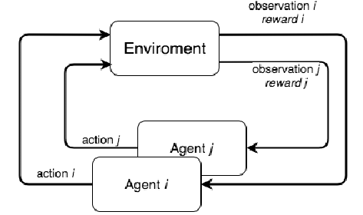
At stage t, each agent i ∈ N selects and executes an action depending on the individual policy 𝜋i ∶ S → P(Ai). The system evolves from state x under the joint action at with respect to the transition probability function P to the next state St+1 while each agent receives Ri as immediate feedback to the state transition. Akin to the single-agent problem, the aim of each agent is to change its policy in such a way as to optimize the received rewards on a predefined horizon T.

Slide 8
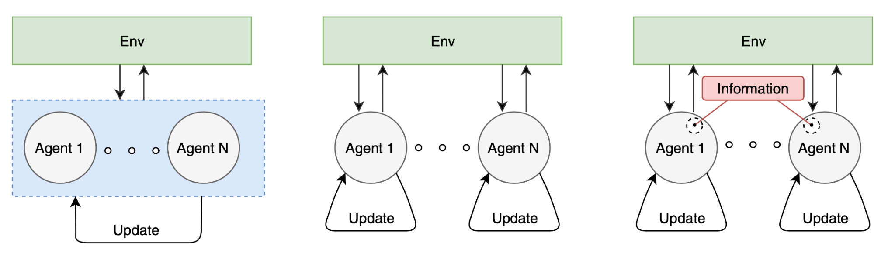
Multi-Agent Training Architectures
Categorized based on
Mutual information
Agents dependency

Slide 9
Decentralized Training
Agents determine actions according to their individual policy for decentralized execution.

Slide 10
Decentralized Training + Shared Information
Each agent holds an individual policy. During training, agents are endowed with additional information.
By sharing mutual information, the training process can be eased and the learning speed can become superior when matched against independently trained agents.
The state-of-the-art practice for MARL.

Slide 11
Centralized Training
Centralized execution describes that agents are guided from a centralized unit, which computes the joint actions for all agents.

Slide 12
Reward Structure
Emergent patterns of agents behavior
The dynamic interaction between multiple decision-makers, which simultaneously affects the state of the environment, can cause the emergence of specific behavioral patterns. An obvious way to influence the development of agent behavior is through the designed reward structure.
Cooperation
Competition
Mixed

Slide 13
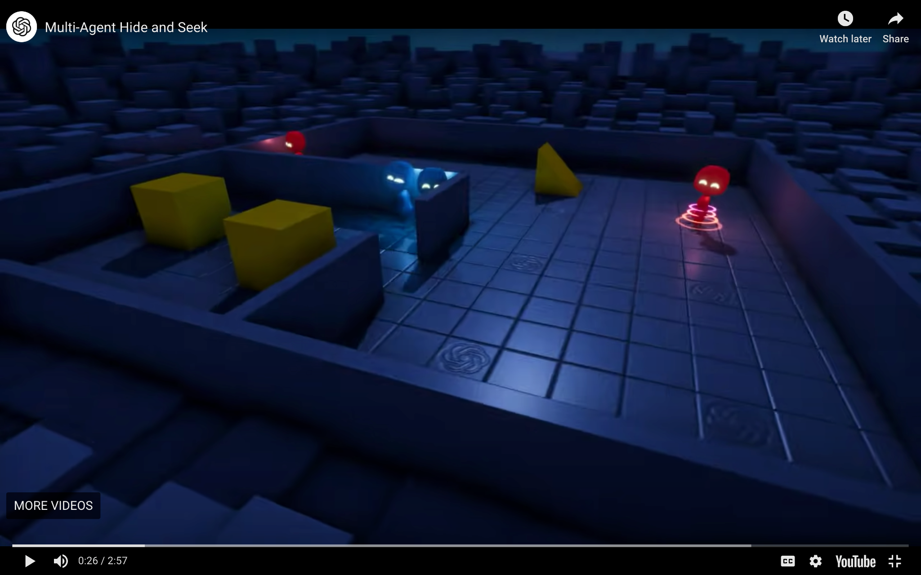
Hide and Seek Game
Setup:
2 blue agents
2 red agents
2 boxes
A ramp

Slide 14
Hide and Seek Game
Simple game, simple rules. The agents can:
Move and rotate themselves
Grab objects
See objects in their sight
Sense distance
Lock and unlock objects
Link to website

Slide 15
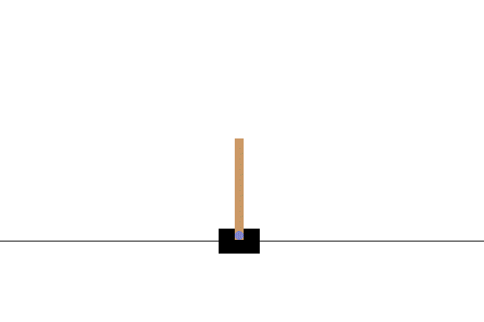
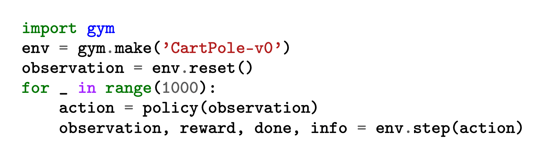
Gym
The Gym interface is simple, pythonic, and capable of representing general RL problems.
action space = { 0, 1 }
observation space = { cart position & velocity, pole angle & angular velocity }

Slide 16
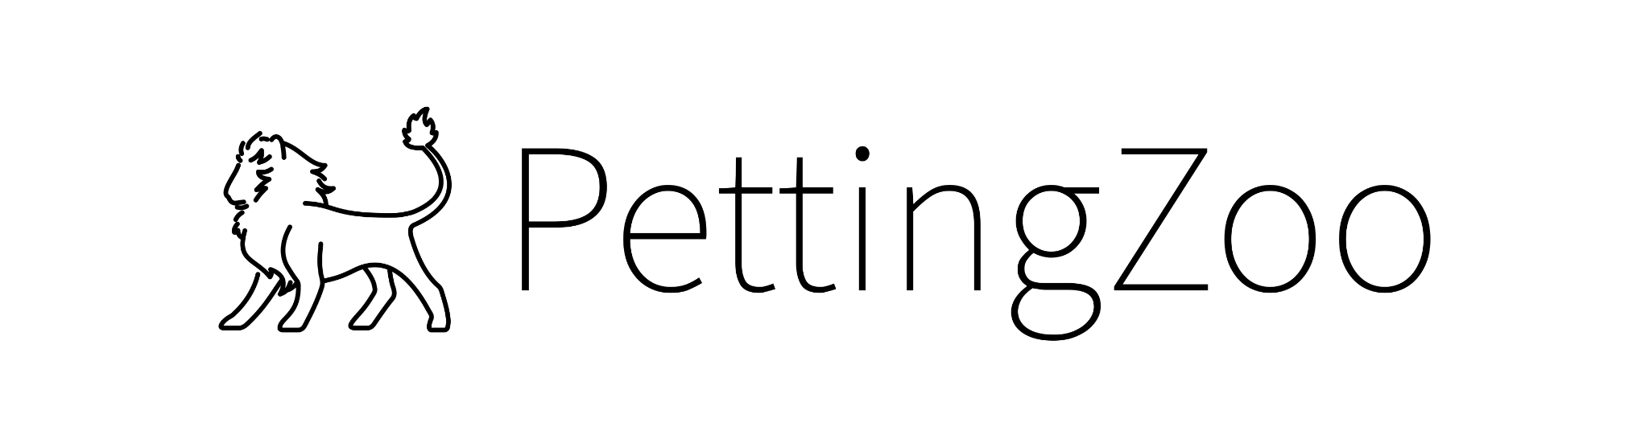
Petting Zoo
PettingZoo is a Python library for conducting research in multi-agent reinforcement learning, akin to a multi-agent version of Gymnasium.
You can see more at here.

Slide 17
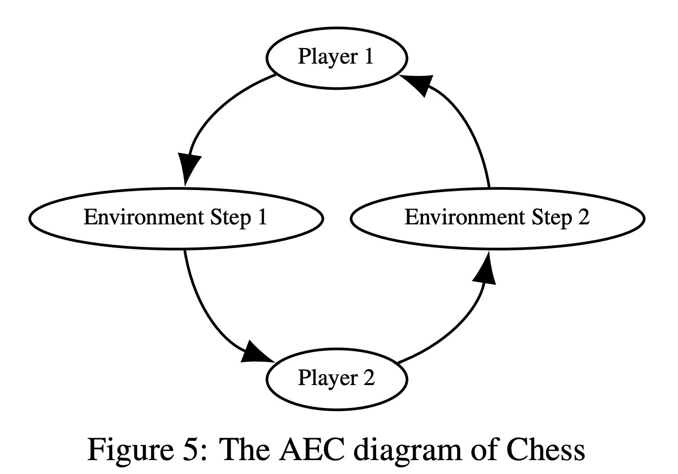
The Agent Environment Cycle Games Model

Slide 18
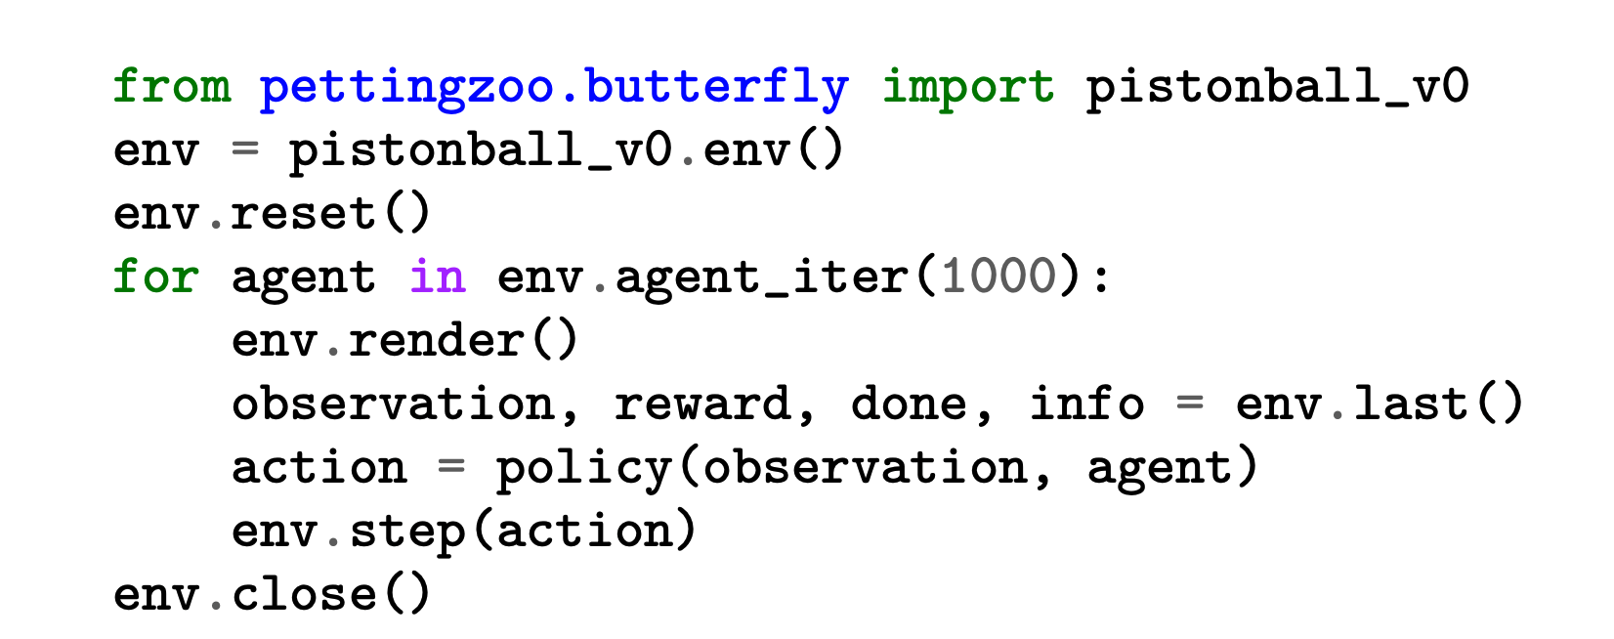
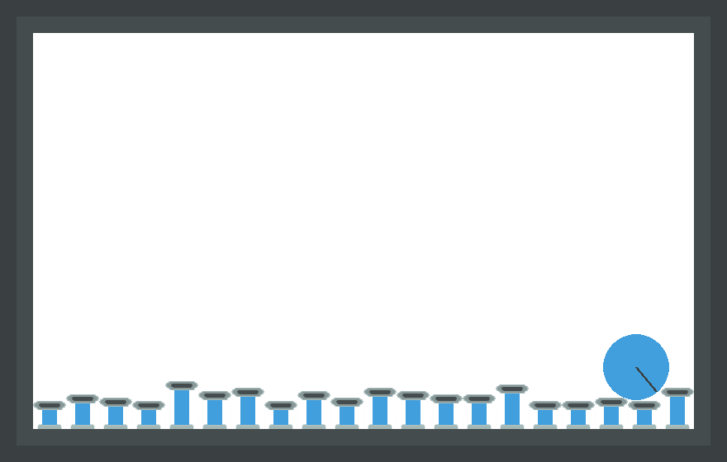
An example of the basic usage of PettingZoo

Slide 19
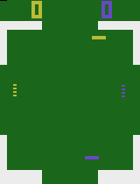

Showcase
Multiple agents playing implemented petting zoo environments:
(if image is static, click to play)
Quadrapong
Knights archers zombies

Slide 20
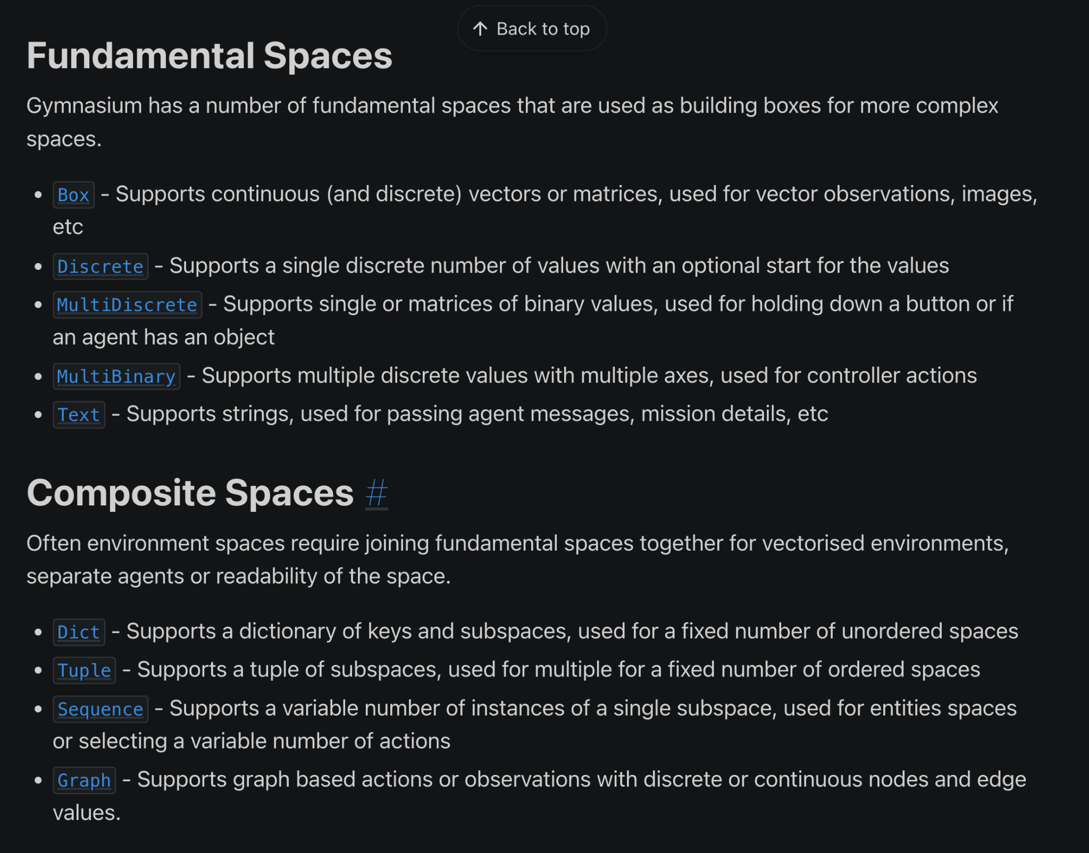
Gym Spaces Data Structure

Slide 21
Let’s see some code!
@googlecolab: Piston - Petting Zoo Sample
@github: repository/code/cartpole_qlearning.py

Slide 22
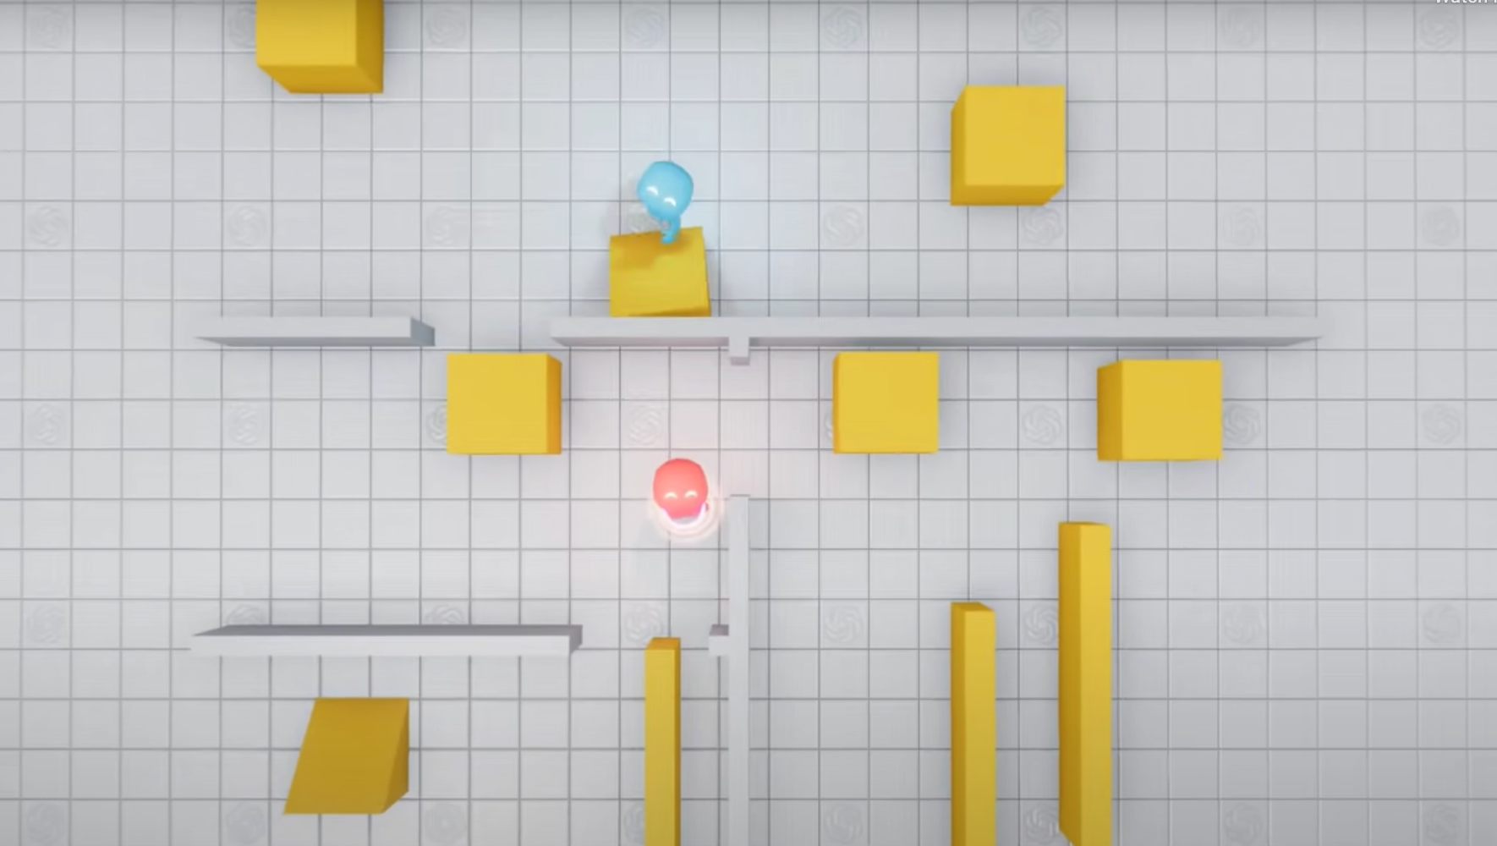
Thank you for your attention!

Slide 23
References
Main reference: Multi-agent deep reinforcement learning: a survey
PettingZoo: PettingZoo: A Standard API for Multi-Agent Reinforcement Learning
https://pettingzoo.farama.org
https://github.com/Farama-Foundation/PettingZoo
Gym: https://www.gymlibrary.dev
https://github.com/openai/gym
Gymnasium (updated version of gym): https://gymnasium.farama.org
Hide & Seek Game: Emergent Tool Use from Multi-Agent Interaction

Slide 24
Contact us: afsharaidam@gmail.com aeirya@gmail.com

